Slide 1
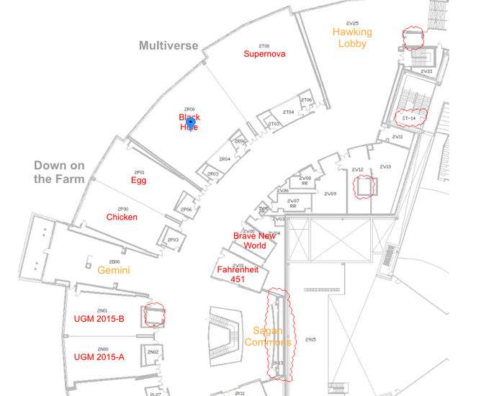
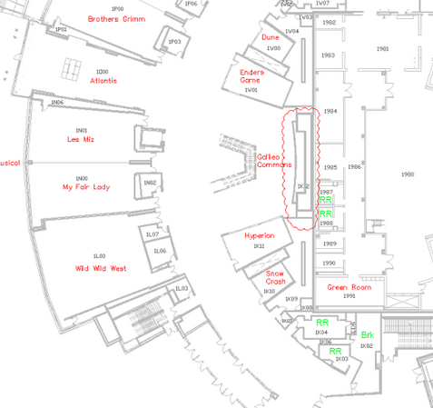
Do not take coffee/tea from the customer break rooms
Do not take coffee/tea from the customer break rooms

Slide 2
Lesson 6
Handling Errors

Slide 3

What could go wrong?
Streams and Files covered in detail later
FileInfo file = new FileInfo("test.txt");
FileStream stream = file.OpenRead();
StreamReader reader = new StreamReader(stream);
while (!reader.EndOfStream)
{
Console.WriteLine(reader.ReadLine());
}
stream.Dispose();
If the file does not exist, an exception is thrown
If the exception is never caught, the program crashes

Slide 4
Why?
Why handle exceptions?
If you don't, your _______________
Makes you (and Epic) _______
When to use?
Deal with "possible" scenarios that are ________ or ________
When not to use?
When _________________ will work
________ workflow scenarios
program will crash
look bad
incorrect
abnormal
conditional branching
Standard

Slide 5
Agenda
Working with Exceptions
Catching Specific Exceptions
Using Exceptions Efficiently
Always Executing Code
Getting Exception Details
Creating Custom Exceptions

Slide 6
Handling Exceptions
throw
Generates an exception
try
Enclose code with possible exceptions
try {
Console.WriteLine("Everything is fine");
throw new Exception("Oh noes!");
Console.WriteLine("All done!");
}
catch (Exception e) {
Console.WriteLine(e.Message);
Console.WriteLine("Everything is !fine");
}
Catch won't return
(unreachable code)
catch
Traps exception from try block
Stack unwinds until catch reached
No catch means program termination
Catch as close to exception as possible
Other properties
StackTrace
HelpLink

Slide 7
Now it won’t crash.
Can we do better?
try
{
FileInfo file = new FileInfo("test.txt");
FileStream stream = file.OpenRead();
StreamReader reader = new StreamReader(stream);
while (!reader.EndOfStream)
{
Console.WriteLine(reader.ReadLine());
}
stream.Dispose();
}
catch (Exception e)
{
Console.WriteLine("There was a problem: " + e.Message);
}
This is not very specific.

Slide 8
Agenda
Working with Exceptions
Catching Specific Exceptions
Using Exceptions Efficiently
Always Executing Code
Getting Exception Details
Creating Custom Exceptions

Slide 9
Catching Specific Exceptions
try {
int quotient = 0, divisor = 0;
quotient = 5 / divisor;
}
catch (DivideByZeroException e) {
Console.WriteLine(e.Message);
}
catch (Exception e) {
Console.WriteLine("not good");
Console.WriteLine(e.Message);
}
First matching exception used
Place catch-all last

Slide 10
Now it’s more specific.
Can we do better?
try
{
FileInfo file = new FileInfo("test.txt");
FileStream stream = file.OpenRead();
StreamReader reader = new StreamReader(stream);
while (!reader.EndOfStream)
{
Console.WriteLine(reader.ReadLine());
}
stream.Dispose();
}
catch (FileNotFoundException e)
{
Console.WriteLine("Missing File: " + e.Message);
}
catch (Exception e)
{
Console.WriteLine("There was some other problem: " + e.Message); }

Slide 11
Now it’s more specific. Can we do better?
Select excerpts from StackOverflow post:
try
{
FileInfo file = new FileInfo("test.txt");
FileStream stream = file.OpenRead();
StreamReader reader = new StreamReader(stream);
while (!reader.EndOfStream)
{
Console.WriteLine(reader.ReadLine());
}
stream.Dispose();
}
catch (FileNotFoundException e)
{
Console.WriteLine("Missing File: " + e.Message);
}
catch (Exception e)
{
Console.WriteLine("There was a problem: " + e.Message); }
A whole bunch of runtime/reflection related stuff happens in order to populate the members of the exception class such as the stack trace object and the various type members etc.
You can expect additional cache misses due to the thrown exception accessing resident data not normally in the cache.
You can expect additional page faults due to the thrown exception accessing non-resident code and data not normally in your application's working set.
[Using exceptions to control process flow] is somewhat akin to using a stick of dynamite to light a toddler's birthday candle

Slide 12
Agenda
Working with Exceptions
Catching Specific Exceptions
Using Exceptions Efficiently
Always Executing Code
Getting Exception Details
Creating Custom Exceptions

Slide 13
Using Exceptions Efficiently
If you can avoid the exception, then do so
If you can’t avoid the exception, handle it as early as possible
If you can only handle some of the exception, re-throw it

Slide 14
Make it Efficient
try
{
FileInfo file = new FileInfo("test.txt");
if (file.Exists)
{
FileStream stream = file.OpenRead();
StreamReader reader = new StreamReader(stream);
while (!reader.EndOfStream)
{
Console.WriteLine(reader.ReadLine());
}
stream.Dispose();
}
else
{
Console.WriteLine(string.Format("The file \"{0}\" doesn't exist.", file.FullName));
}
}
catch (Exception e)
{
Console.WriteLine("There was some other problem: " + e.Message);
throw;
}
Add if you expect other exceptions that can’t be avoided
Avoids FileNotFound Exception
Add if calling code should also see the exception because you can’t fully handle it

Slide 15
It’s Efficient. Can we do better?
try
{
FileInfo file = new FileInfo("test.txt");
if (file.Exists)
{
FileStream stream = file.OpenRead();
StreamReader reader = new StreamReader(stream);
while (!reader.EndOfStream)
{
Console.WriteLine(reader.ReadLine());
}
stream.Dispose();
}
else
{
Console.WriteLine(string.Format("The file \"{0}\" doesn't exist.", file.FullName));
}
}
catch (Exception e)
{
Console.WriteLine("There was some other problem: " + e.Message);
throw;
}
The stream won’t close until garbage collection occurs if an exception is thrown before this line.

Slide 16
Agenda
Working with Exceptions
Catching Specific Exceptions
Using Exceptions Efficiently
Always Executing Code
Getting Exception Details
Creating Custom Exceptions

Slide 17
Always Executing Code
e.g., database connection, file stream, ActiveX component
try {
// Obtain unmanaged resource
}
finally {
// Release unmanaged resource
}
finally
Indicate code that always executes
Allow lower stack level to catch
try {
throw new Exception("Oops!");
}
catch {
throw new Exception("Oops, I did it again!");
}
finally {
Console.WriteLine("I still execute!");
}
Executes even if catch throws exception
If the exception is never caught and the program crashes, finally may not run (depends on certain CLR settings).

Slide 18
Stream Closed Immediately
FileStream stream = null;
try
{
FileInfo file = new FileInfo("test.txt");
if (file.Exists)
{
stream = file.OpenRead();
StreamReader reader = new StreamReader(stream);
while (!reader.EndOfStream) { Console.WriteLine(reader.ReadLine()); } }
else
{
Console.WriteLine(string.Format("The file \"{0}\" doesn't exist.", file.FullName));
}
}
catch (Exception e)
{
Console.WriteLine("There was a problem: " + e.Message);
}
finally
{
if(stream != null)
{
stream.Dispose();
}
}
Objects must be instantiated outside of the try block to be used inside of a catch or finally block
Always check for null before referencing properties/methods of objects assigned inside the try block

Slide 19
Agenda
Working with Exceptions
Catching Specific Exceptions
Using Exceptions Efficiently
Always Executing Code
Getting Exception Details
Creating Custom Exceptions

Slide 20
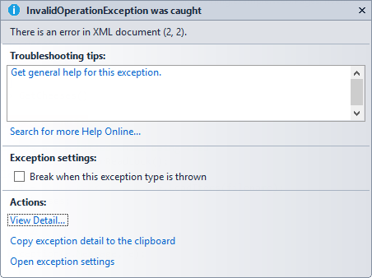
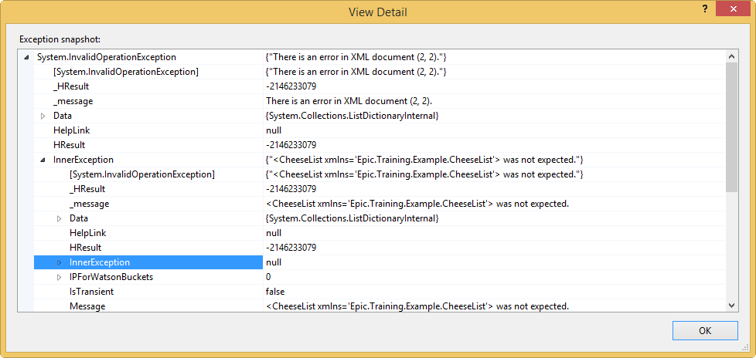
Getting Exception Details
1. You see a vague error
3. Examine InnerException
5. The root error
2. Follow for details
4. Dig until there are no more InnerExceptions

Slide 21
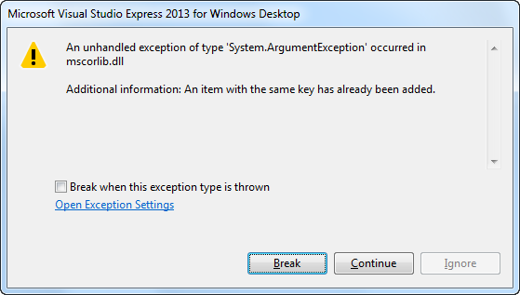
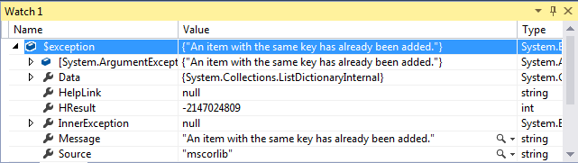
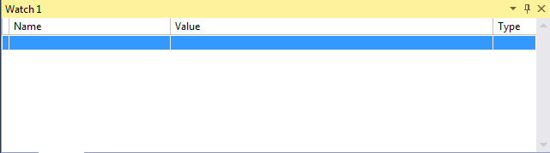
In VS Express
1. Basic info here
3. Debug > Windows > Watch > Watch1
2. Click “Break”
3. For details, expand the variable $exception

Slide 22
Agenda
Working with Exceptions
Catching Specific Exceptions
Using Exceptions Efficiently
Always Executing Code
Getting Exception Details
Creating Custom Exceptions

Slide 23
Creating Custom Exceptions
Name ends with Exception
Derives from System.Exception
public class RemarkableException : System.Exception {
public string Remarks { get; protected set; }
public RemarkableException(string message, string remarks) :base(message)
{
Remarks = remarks;
}
}
Add state / behavior
Call base constructor and pass a message string
Throw custom exception
try {
throw new RemarkableException("Error message", "Remarks...");
}
catch(RemarkableException e) {
// Handle your exception
}
Catch custom exception

Slide 24
Activity: Error Handling
Add error handling to the employee solution

